Slide 1
Update to the Board on Our Commitment to Excellence and Equity in our Educational Practices
November 30, 2020
Presented By:
Damaris Garrett, Director, Equity & Compliance
Jacquelyn Johnson, Director, REAA
Michael Tappler, Psychometrician, REAA

Slide 2
Adopted from: The Organization for Economic Co-Operation and Development (OECOD)
Educational Equity or “equity in education” is the measure of fairness and inclusive opportunities in education. That is essentially two dimensions of this framework:
Fairness, which means ensuring that personal and social circumstances do not prevent students from academic achievement.
Inclusion, which means ensuring a basic minimum standard of expectation for education of all students regardless of background, personal characteristics, socio-economic background or residence.

Slide 3
Equality vs. Equity
While equality means treating every student the same, equity requires putting systems in place to ensure that every child has an equal chance for success.
This means understanding the unique challenges and barriers faced by individual students, or by populations of students, and providing additional supports to help them overcome them.

Slide 4
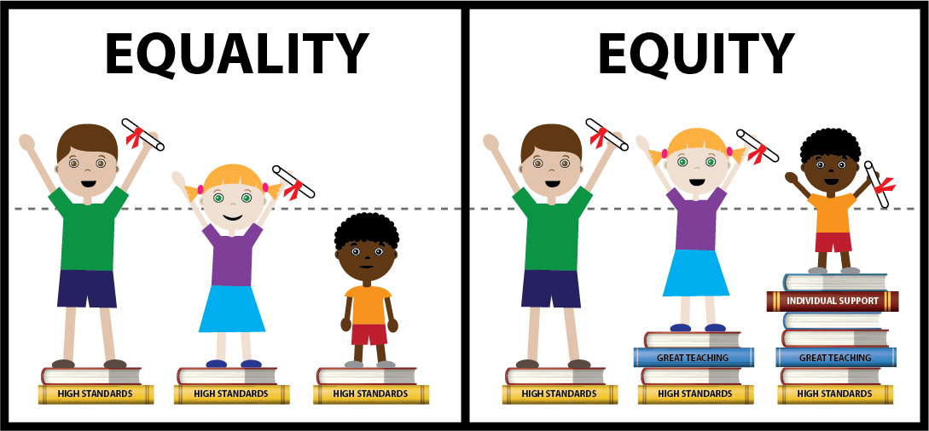

Slide 5
WHAT ARE WE DOING IN CCPS?
WE HAVE:
… developed a comprehensive equity policy that highlights our belief statements about the District’s goals and efforts in support of excellence and equity in our educational practices
… created an Equity Committee that will be comprised of a cross-representative group of staff from across the District and community members to take a deep dive into our educational practices
… initiated a project that will entail a two-phased approach for comprehensiveness towards this work. The first phase will be an internal review and analysis of our data to identify areas where there are opportunities to address systemic practices. The second phase, if desired after the internal review, is to commission an external, third-party equity study.

Slide 6
Programmatic equity - Do all students have access to high-quality content that fits their educational needs? What support is provided for students who need extra help to achieve academic goals? Do all students have highly qualified teachers who are well prepared to meet their needs?
Resource equity - Is school funding and resources allocation equitable? Do schools serving populations with greater needs have access to the resources they need to effectively serve these students? Do we differentiate how we assign resources to ensure that we provide an environment that promotes educational equity?
Achievement equity - Are all students held to high performance standards? Do we model standards of expectation for all? How are standards modified to accommodate students with special needs or skills?

Slide 7
* Equity Committee will continue its focus on crucial work of data review --- --- develop plan for systemic analysis --- ensure updates though Quarterly reports and/or presentations * Divisions/departments will conduct detailed look at processes and practices --- --- address any immediate instances of equity concerns --- continue to champion efforts that support equity
NEXT STEPS:

Slide 8
QUESTIONS?

